Slide 1
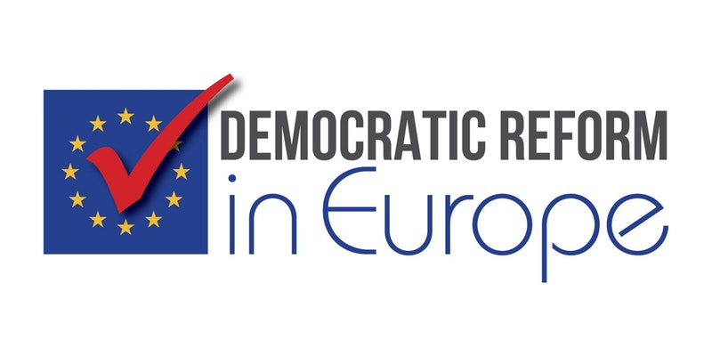
Conference
November 5-6, 2017
Austin, Texas
Monetary, Debt and Policy Reform
Kunibert Raffer

Slide 2
Monetary Policy Reform
Monetary Policy must not try to substitute fiscal policy unwisely curbed severely by EU politicians apparently to outlaw Keynesian policies
QE, Outright Monetary Transactions (OMT) scheme, Expanded Asset Purchase Programme must stop, high liquidity not efficient – BUT: downsizing bubble will be difficult (eurozone gvts depend on low interest rates created by ECB) and it will take much time, meanwhile destroying private provisions for old age and expropriating private wealth; conditionality (OMT) has to go as well - no central bank task to substitute wantonly restricted fiscal policy
Abolish self-imposed dependence on CRAs [3 other sources: national central banks’ in-house credit assessment systems (ICASs) and one third-party providers’ rating tool (RT – Italian non-financial corporations] - Eurosystem credit assessment framework (ECAF) as of 13 Oct 2017 [source “counterparties’ internal ratings-based (IRB) systems” mentioned but not used] – BUT “last three types of credit
assessment system are used mainly to assess non-marketable collateral such as credit claims.”
DBRS (Dominion Bond Rating Service) ?

Slide 3
“Lesser-known DBRS … only ECB-recognised rating agency to rate Por-tugal above junk status. Its rating, which has remained at investment grade since 2011, has safeguarded the country’s eligibility for the ECB’s bond-buying programme”
FT 21 April 2017
ECB: 1 Jan 2008 DBRS can be used as a new External Credit Assessment Institution (ECAI) source within the Eurosystem Credit Assessment Framework (ECAF)
ECB/2014/10 lowered threshold of acceptable ratings from DBRS
German rating firm Scope seeks ECB recognition (Reuters 24 Aug 2016)
Abolishing dependence on CRAs! Direct lending to member states – either within predetermined limits or at the ECB‘s discretion – should be at least discussed (changing/abolishing Art 123 TFEU)
Actual policies: destroying prosperity in eurozone coutries – difficult to assume that this is not willingly done

Slide 4
June 2017 INSEE (Institut National de la Statitique et des Etudes Economiques) - top managers (chefs d‘entreprises) see two main barriers to employment: economic insecurity (28%), lack of competent labour (27%); labour costs & legal problems when laying-off workers less important;
Gvt Macron: reducing labour costs main policy
Andrè Grjebin, Le Monde 5 Oct 2017, p.7,
Learning from the FED
Interdistrict Settlement Account (ISA) avoids Target 2 disequilibria
- ECB should have copied/established this or a similar mechanism

Slide 5
Reforming Policies Regarding Sovereign Debt
Addendum to Art 125 (Treaty on the Functioning of the European Union – (no bailout clause) regulating case of insolvency (e.g. Art 125a); first best – sovereign insolvency mechanism (preferably Raffer Proposal);
Question: why euro area model CACs not already stipulated simultaneously with Art 125? (in Greece de facto not a big problem)
Do away with Maastricht criteria (only purpose to outlaw Keynesian policies), “Growth” and Stability Pact, European Semester - one official goal of “G”&S Pact: “preventing excessive macroeconomic imbalances in the EU” – cf balance of payments; ESM needed?
Maastricht’s economic imperative: 2017 Q1: government debt/GDP in euro area (EA19) 89.5% (Eurostat) at the time euro was introduced euroland had a ratio 70.6 (70.7) (1999) 67.0 (67.1) in 2001
Countries >100% when joining eurozone: Belgium, Italy; Greece 107.1 in 2001 when joining (98.9 in 1999 when Greece was left out of eurozone for failing to meet the EU's economic criteria)

Slide 6
BREATHING REAL LIFE INTO SUBSIDIARITY PRINCIPLE: REDU-CING EU INTERFERENCE INTO FISCAL AND OTHER POLICIES
NO Eurobonds – would distort market signals for less creditworthy members; essentially the distortion that produced the eurocrisis (or stronghanded undemocratic intervention by richer countries)
NO European “Ministry of Finance“ (resources?, criteria similar to Maastricht? If so, how? Art 123 TFEU covering „Union institutions, bodies, offices or agencies”; if not, why difference to national budgets?)
No extra Parliament of Eurocountries
Reducing interference in day-to-day matters, e.g., light bulbs, curvature of cucumbers (abolished in 2009), small pots of olive oil (stopped by protests), Cableway Directive (2000/9/EC) Berlin or Mecklenburg-Vorpommern HAD to pass laws although they have NO cableways; Dirndl
Transfer any de facto legislative powers from politicians to a SMALLER EU-Parliament (national vetos can be incorporated into parliamentary voting), NO longer co-legislator with Council BUT SOLE legislator; NO LONGER Commission, the only institution empowered to initiate legislation (But EP can “ask” Commission to present legislative proposals,)
Danger for democracy – further interventions by Brussels into national budgets, the very own right of national parliaments

Slide 7
REFORMING POLICIES TO ABOLISH THE “DEMOCRACY DEFICIT” - SAVING DEMOCRACY
Greece: one referendum stopped by pressure, other ignored by EU-creditors; ECB capped ELA before referendum, releasing more funds again after Greek Parliament voted for those “reforms” forced on Greece by creditors - BUT EU generally against referenda (=the people)
Successful ICELAND: referenda on foreign debt!!!!!!
After Dutch referendum clearly rejecting association agreement with Ukraine Rebecca Harms, head of the Green party in EU Parliament, demanded abolishing direct democracy (decisions by the sovereign) as this could “endanger existence” of EU = EU apparently not compatible with democracy. No national referenda! Harms seconded by Martin Schulz (defends the “civilization project” Europe = EU without people’s direct participation or government against the people).
Spiegel, 8 April 2016
http://www.spiegel.de/politik/ausland/referendum-in-den-niederlanden-harms-ist-gegen-volksabstimmungen-a-1086067.html
Magic bullet against democracy – Juncker‘s „honest lie“?

Slide 8
Making Textbook Economics Work - Saving Democracy
Presently: impunity guarantees reckless behaviour by politicians, preventive role of accountability. So far only Iceland has at least tried to make people causing crises accountable
EXAMPLE: bailout prohibition for euro-countries would – if not violated –have precluded detrimental effects on human rights and development and solved the crisis efficiently
Different opinion: Court of the EU (nomen est omen!!)
SECOND EXAMPLE:
Soros (FT) - banks “obliged to hold riskless assets to meet their liquidity requirements were induced to load up on the sovereign debt of the weaker countries to earn a few extra basis points”
Basel I & II: too low capital weights for euro problem countries; but at least Basel II, though dependence on Credit Rating Agencies, tried to improve - EU exacerbates situation - capital requirements directive:
zero capital weight for EU-members borrowing in their own currency; exempting highly rated countries from “large exposure” limit - REGULATORY ORIGINAL SIN

Slide 9
Thank you!
¡Muchas gracias!
Kunibert Raffer
http://homepage.univie.ac.at/Kunibert.Raffer
© Kunibert Raffer 2017

